Slide 1



CARCINO (BREAST CANCER PREDICTION)
Guided By: Prof. Mouna M Naravani
Done By : Ankitha Chowdary (18BBTCS011)

Slide 2

AGENDA
Introduction
Abstract
Problem solving
System Requirements
Literature survey
Design

Slide 3
Introduction
Breast cancer is the uncontrolled growth of breast cells. It represents the second cause of cancer death in women worldwide. Breast cancer is caused due to the abnormal growth of some cells in the breast. Several techniques have been introduced for the correct diagnosis of breast cancer.
Every single minute, anywhere all over the globe context of breast cancer is identified amongst females and somebody expires from breast cancer.

Slide 4
Breast cancer occurs as a result of abnormal growth of cells in the breast tissue, commonly referred to as a tumor. A tumor does not mean cancer — can be benign (no breast cancer) or malignant (breast cancer). Tests such as an MRI, mammogram, ultrasound, and biopsy are commonly used to diagnose breast cancer.
Breast tumors can be identified and further classified into three different categories known as:
benign breast cancers
in situ cancers
invasive cancers.

Slide 5
Abstract
Breast cancer is the uncontrolled growth of breast cells. It represents the second cause of cancer death in women worldwide. It is important for patients to understand their disease and know what to expecting the future so that they can make decisions about treatment, rehabilitation, financial aid decisions and personal matters. This paper presents an approach for diagnosing breast cancer based on a set of input variables that describe some characteristics of tumor images. The proposed approach builds a binary logistic model that classifies between malignant and benign cases. In addition to the simplicity of the used model, the reduced set of features gives performance measures that outperform similar approaches. Accordingly, the presented approach can be used for feature selection and reduction of the breast cancer data.

Slide 6
Problem solving
Breast Cancer is one of the leading cancer developed in many countries including India.
Though the endurance rate is high – with early diagnosis 97% women can survive for more than 5 years.
Statistically, the death toll due to this disease has increased drastically in last few decades. The main issue pertaining to its cure is early recognition.

Slide 7
This analysis aims to observe which features are most helpful in predicting malignant or benign cancer and to see general trends that may aid us in model selection and hyper parameter selection.
The goal is to classify whether the breast cancer is benign or malignant.

Slide 8
System Requirements
Hardware:
4 GB RAM minimum, 8 GB RAM recommended.
1.5 GB hard disk space + at least 1 GB for caches.
1024x768 minimum screen resolution
Software :
64-bit versions of Microsoft Windows
Language : Python , Pandas and Sklearn
IDE : Jupyter Notebook / Google Colab

Slide 9
Literature survey
“Predicting Breast Cancer using Logistic Regression and Multi-Class Classifiers”, J.sultan November 2018.
“Breast cancer analysis using Logistic Regression”, H. Yusuff.

Slide 10
Design
Loading Dataset
Visualizing the data, finding correlation among features and target label
Pre-processing data
Splitting the data into training samples and testing samples

Slide 11
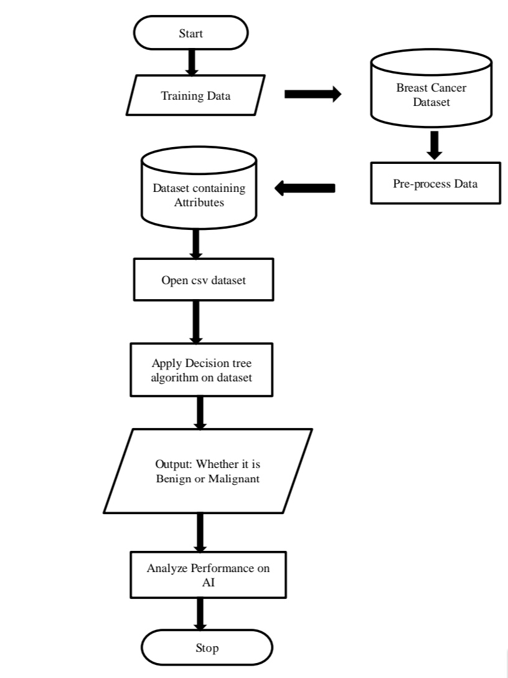
Flow Chart

Slide 12
THANK YOU

